Slide 1
Chapter 5: Working with data sets

Slide 2
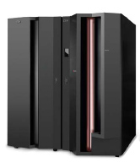
Chapter objectives
Be able to:
Explain what a data set is
Describe data set naming conventions and record formats
List some access methods for managing data and programs
Explain what catalogs and VTOCs are used for
Be able to create, delete, and modify data sets

Slide 3
Key terms in this chapter
block size
catalog
data set
high level qualifier (HLQ)
library
logical record length (LRECL)
member
PDS and PDSE
record format (RECFM)
system managed storage (SMS)
virtual storage access method (VSAM)
VTOC

Slide 4
What is a data set?
Take screenshot 1
A data set is a collection of logically related data records stored on one disk storage volume or a set of volumes.
A data set can be:
  a source program
  a library of macros
  a file of data records used by a processing program.
You can print a data set or display it on a terminal. The logical record is the basic unit of information used by a program running on z/OS.

Slide 5
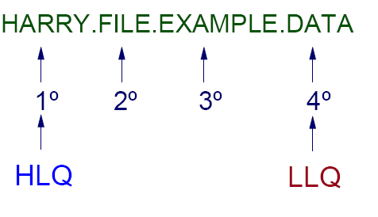
Dataset Naming

Slide 6
What an access method is
Defines the technique used to store and retrieve data.
Includes system-provided programs and utilities to define and process data sets.
Commonly used access methods include the following:
  VSAM, QSAM, BSAM, BDAM, and BPAM.

Slide 7
DASD: Use and terminology
Direct Access Storage Device (DASD) is another name for a disk drive.
DASD volumes are used for storing data and executable programs.
Data sets in a z/OS system are organized on DASD volumes.
  A disk drive contains cylinders
  Cylinders contain tracks
  Tracks contain data records.

Slide 8
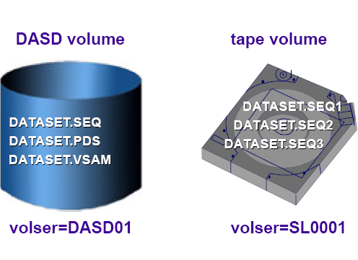
Datasets

Slide 9
Using a data set
To use a data set, you first allocate it. Then, access the data using macros for the access method that you have chosen.
Various ways to allocate a data set:
  ISPF data set panel, option 3.2
  Access Method Services
  TSO ALLOCATE command
  job control language (JCL)
Notes:
To use a data set, you first allocate it (establish a link to it), then access the data using
macros for the access method that you have chosen.
The allocation of a data set means either or both of two things:
To set aside (create) space for a new data set on a disk.
To establish a logical link between a job step and any data set.

Slide 10
Allocating space on DASD volumes
How space is specified:
  explicitly (SPACE parameter)
  implicitly (SMS data class)
Logical records and blocks:
  Smallest amount of data to be processed
  Grouped in physical records named blocks
Data set extents:
  Space for a disk data set is assigned in extents
Notes:
You can specify the amount of space required in blocks, records, tracks, or cylinders.
When creating a DASD data set, you specify the amount of space needed explicitly (by
using the SPACE parameter), or implicitly (by using the information available in a data
class).
The system can use a data class if SMS is active even if the data set is not SMS managed.
For system-managed data sets, the system selects the volumes, saving you from having to
specify a volume when you allocate a data set.
If you specify your space request by average record length, space allocation is
independent of device type. Device independence is especially important to
system-managed storage.
A logical record (LRECL) is a unit of information about a unit of processing (for
example, a customer, an account, a payroll employee, and so on). It is the smallest
amount of data to be processed, and it is comprised of fields which contain information
recognized by the processing application.
Logical records, when located in DASD, tape, or optical devices, are grouped in physical
records named blocks (BLKSIZE). Each block of data on a DASD volume has a distinct
location and a unique address, thus making it possible to find any block without
extensive searching. Logical records can be stored and retrieved either directly or
sequentially.
The maximum length of a logical record (LRECL) is limited by the physical size of the
used media.
Space for a disk data set is assigned in extents. An extent is a contiguous number of disk
drive tracks (or cylinders). Data sets can increase in extents as they grow. Older types of
data sets can have up to 16 extents per volume. Newer types of data sets can have up to
128 or 255 extents.
In z/OS, a data set organization based on extents is designed to maximize disk
performance. Reading or writing contiguous tracks is faster than reading or writing tracks
scattered over the disk, as might be the case if tracks were allocated dynamically.

Slide 11
Data set record formats
F
record
record
record
record
Fixed records.
block
block
FB
record
record
record
record
record
record
Fixed blocked records. BLKSIZE = n * LRECL
V
record
record
record
Variable records.
RDW
block
block
VB
record
record
record
record
record
BDW
Variable blocked records. BLKSIZE >= 4 + n * largest LRECL
U
record
record
record
record
Undefined records. No defined internal structure for access method.
Record and block descriptors words are each 4 bytes long
Notes:
Traditional z/OS data sets are record oriented. In normal usage, there are no byte stream
files such as are found in PC and UNIX systems. (z/OS UNIX has byte stream files, and
byte stream functions exist in other specialized areas. These are not considered to be
traditional data sets.)
In z/OS, there are no new line (NL) or carriage return and line feed (CR+LF) characters
to denote the end of a record. Records are either fixed length or variable length in a given
data set. When editing a data set with ISPF, for example, each line is a record.
Traditional z/OS data sets have one of five record formats, as shown on the slide. We must
stress the difference between a block and a record. In this discussion,
a block is what is written on disk, while a record is a logical entity.
F - Fixed This means that one physical block on disk is one logical
record and all the blocks/records are the same size. This
format is seldom used.
FB - Fixed Blocked This means that several logical records are combined into one
physical block. This can provide efficient space utilization and
operation. This format is commonly used for fixed-length
records.
V - Variable This format has one logical record as one physical block. The
application is required to insert a four-byte Record Descriptor
Word (RDW) at the beginning of the record. The RDW
contains the length of the record plus the four bytes for the
RDW. This format is seldom used.
VB - Variable Blocked This format places several variable-length logical records
(each with an RDW) in one physical block. The software must
place an additional Block Descriptor Word (BDW) at the
beginning of the block, containing the total length of the
block.
U - Undefined This format consists of variable-length physical
records/blocks with no predefined structure. Although this
format may appear attractive for many unusual applications, it
is normally used only for executable modules.

Slide 12
Types of data sets
We discuss three types in this class:
  Sequential, partitioned, and VSAM
A sequential data set is a collection of records written and read in sequential order from beginning to end.
A partitioned data set (PDS) is a collection of sequential data sets, called members.
  Consists of a directory and one or more members.
  Also called a library.
A PDSE is a partitioned data set extended.
Notes:
The simplest data structure in a z/OS system is a sequential data set. It consists of one or
more records that are stored in physical order and processed in sequence. New records
are appended to the end of the data set.
An example of a sequential data sets might be an output data set for a line printer or a
deck of punch cards.
A z/OS user defines sequential data sets through job control language (JCL) with a data
set organization of PS (DSORG=PS), which stands for physical sequential. In other
words, the records in the data set are physically arranged one after another.
A partitioned data set adds a layer of organization to the simple structure of sequential
data sets. A PDS is a collection of sequential data sets, called members. Each member is
like a sequential data set and has a simple name, which can be up to eight characters long.
A PDS also contains a directory. The directory contains an entry for each member in the
PDS with a reference (or pointer) to the member. Member names are listed alphabetically
in the directory, but members themselves can appear in any order in the library. The
directory allows the system to retrieve a particular member in the data set.
A partitioned data set is commonly referred to as a library.
A PDSE is a partitioned data set extended. It consists of a directory and zero or more
members, just like a PDS. It can be created with JCL, TSO/E, and ISPF, just like a PDS,
and can be processed with the same access methods. PDSE data sets are stored only on
DASD, not tape.

Slide 13
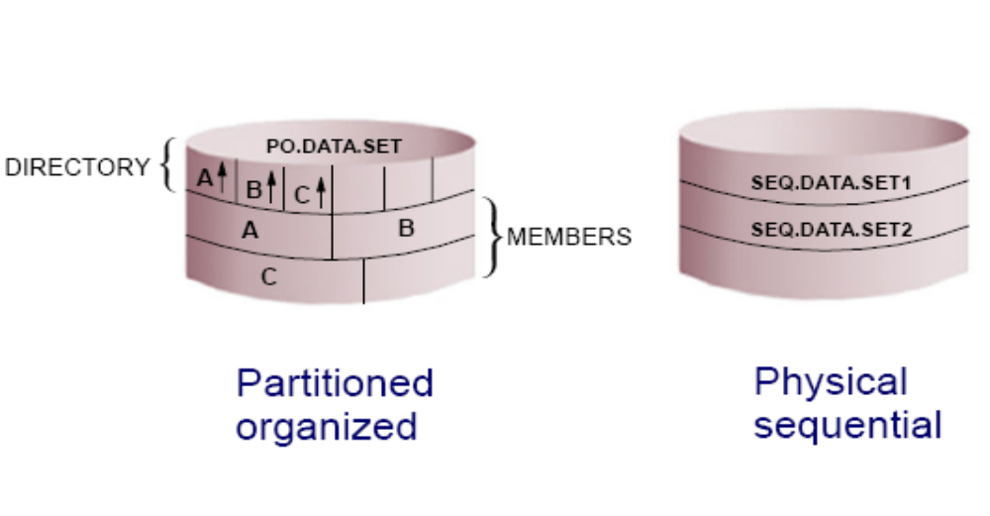
Types of Non-VSAM datasets

Slide 14
PDS versus PDSE
PDS data sets:
  Simple and efficient way to organize related groups of sequential files.
PDSE data sets:
  Similar to a PDS, but advantages include:
    Space reclaimed automatically when a member is deleted
    Flexible size
    Can be shared
    Faster directory searches
Notes:
A PDS data set offers a simple and efficient way to organize related groups of sequential
files. A PDS has the following advantages for z/OS users:
Grouping of related data sets under a single name makes z/OS data management
easier. Files stored as members of a PDS can be processed either individually or all
the members can be processed as a unit.
Because the space allocated for z/OS data sets always starts at a track boundary on
disk, using a PDS is a way to store more than one small data set on a track. This saves
you disk space if you have many data sets that are much smaller than a track. A track
is 56,664 bytes for 3390 disk device.
Members of a PDS can be used as sequential data sets, and they can be appended (or
concatenated) to sequential data sets.
Multiple PDS data sets can be concatenated to form large libraries.
PDS data sets are easy to create with JCL or ISPF; they are easy to manipulate with
ISPF utilities or TSO commands.
However, some aspects of the PDS
design affect both performance and the efficient use of disk storage, as follows:
Wasted space. When a member in a PDS is replaced, the new data area is written to a
new section within the storage allocated to the PDS. When a member is deleted, its
pointer is deleted too, so there is no mechanism to reuse its space.
Limited directory size. The size of a PDS directory is set at allocation time. As the
data set grows, it can acquire more space in units of the amount you specified as its
secondary space. These extra units are called secondary extents.
However, you can only store a fixed number of member entries in the PDS directory
because its size is fixed when the data set is allocated. If you need to store more
entries than there is space for, you have to allocate a new PDS with more directory
blocks and copy the members from the old data set into it.
Lengthy directory searches. Entries are searched sequentially in alphabetical order. If the directory is very
large and the members small, it might take longer to search the directory than to
retrieve the member when its location is found.
In many ways, a PDSE is similar to a PDS. Each member name can be eight bytes long.
For accessing a PDS directory or member, most PDSE interfaces are indistinguishable
from PDS interfaces. Both PDS and PDSE data sets are processed using the same access
methods (BSAM, QSAM, BPAM).
However, PDSE data sets have a different internal format, which gives them increased
usability. You can use a PDSE in place of a PDS to store data, or to store programs in the
form of program objects. A program object is similar to a load module in a PDS. A load
module cannot reside in a PDSE and be used as a load module. One PDSE cannot contain
a mixture of program objects and data members.
PDSE data sets have several features that can improve user productivity and system
performance. The main advantage of using a PDSE over a PDS is that a PDSE
automatically reuses space within the data set without the need for anyone to periodically
run a utility to reorganize it.
Also, the size of a PDS directory is fixed regardless of the number of members in it,
while the size of a PDSE directory is flexible and expands to fit the members stored in it.
Further, the system reclaims space automatically whenever a member is deleted or
replaced, and returns it to the pool of space available for allocation to other members of
the same PDSE. The space can be reused without having to do an IEBCOPY compress.

Slide 15
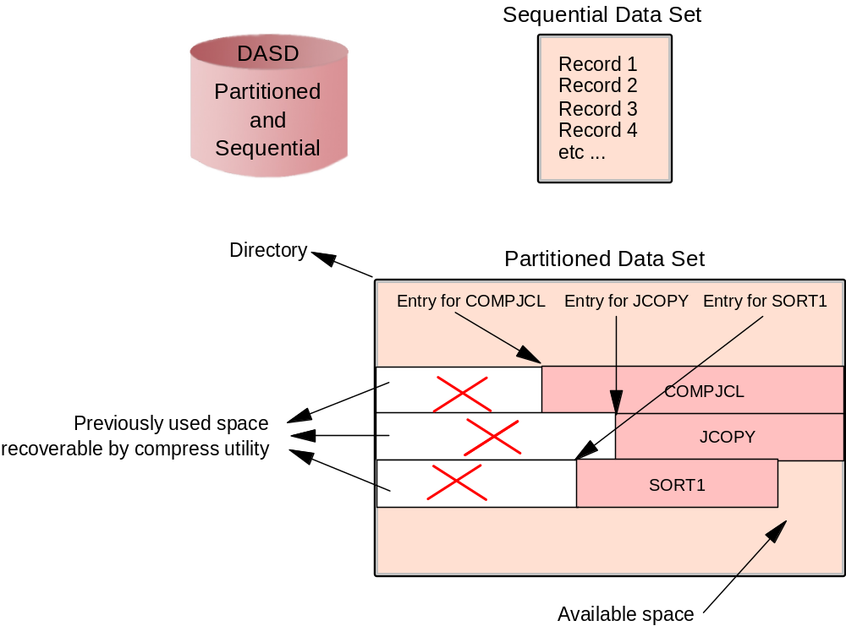
What is a data set, and how is it stored
Notes:
A data set is a collection of logically related data; it can be a source program, a library of
programs, or a file of data records used by a processing program. Data records are the
basic unit of information used by a processing program.
z/OS data sets are allocated in contiguous extents on a disk to enhance performance.
Users must define the amount of space to be allocated for a data set (before it is used). A
data set may occupy more than one extent and extents may be added dynamically.
Almost all z/OS data processing is record-oriented. Byte stream files are not present in
traditional processing, although they are a standard part of z/OS UNIX. z/OS records
(and physical blocks) are in one of several well-defined formats. Most data sets have
DCB attributes that include the record format (RECFM—F, FB, V, VB, U), the maximum
logical record length (LRECL), and the maximum block size (BLKSIZE).
When a member in a PDS is replaced, the new data area is written to a
new section within the storage allocated to the PDS. When a member is deleted, its
pointer is deleted too, so there is no mechanism to reuse its space. This wasted space
is often called gas and must be periodically removed by reorganizing the PDS, for
example, by using the utility IEBCOPY to compress it.

Slide 16
How data is stored in a z/OS system
Data is stored on a direct access storage device (DASD), magnetic tape volume, or optical media.
You can store and retrieve records either directly or sequentially.
You use DASD volumes for storing data and executable programs, including the operating system itself, and for temporary working storage.
You can use one DASD volume for many different data sets, and reallocate or reuse space on the volume.
Notes:
In a z/OS system, data can be stored on a direct access storage device (DASD), magnetic
tape volume, or optical media. The term DASD applies to disks or simulated equivalents
of disks. All types of data sets can be stored on DASD, but only sequential data sets can
be stored on magnetic tape. We discuss the types of data sets later in this module.

Slide 17
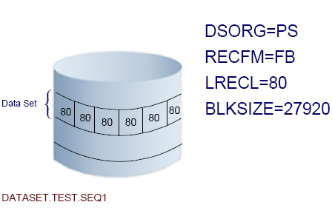
General Dataset Specifications

Slide 18
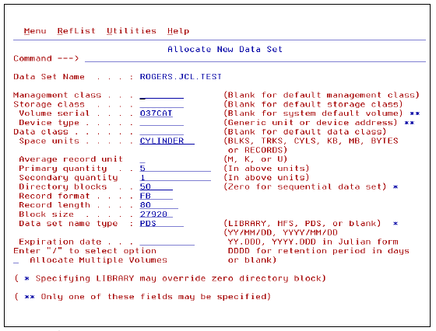
Allocating a Dataset in ISPF

Slide 19
How data sets are named
Data set naming convention
  Unique name
    Maximum 44 characters
  Maximum of 22 name segments: level qualifier
    The first name in the left: high level qualifier (HLQ)
    The last name in the right: low level qualifier (LLQ)
    Level qualifiers are separated by '.'
  Each level qualifier:
    From 1 up to 8 characters
    The first must be alphabetical (A-Z) or special (@ # $)
    The 7 remaining: alphabetical, national, numeric (0-9) or hyphen (-)
    Upper case only
  Example: MYID.JCL.FILE2 HLQ: MYID 3 qualifiers
Member name of partitioned data set
  8 bytes long
  First byte: alphabetical (A-Z) or special (@ # $)
  The 7 remaining: alphabetical, special, numeric (0-9)
Notes:
When you allocate a new data set (or when the operating system does), you must give the
data set a unique name.
A data set name can be one name segment, or a series of joined name segments. Each
name segment represents a level of qualification. For example, the data set name
VERA.LUZ.DATA is composed of three name segments. The first name on the left is
called the high-level qualifier (HLQ), the last name on the right is the lowest-level
qualifier (LLQ).
Segments or qualifiers are limited to eight characters, the first of which must be
alphabetic (A to Z) or special (# @ $). The remaining seven characters are either
alphabetic, numeric (0 - 9), special, a hyphen (-). Name segments are separated by a
period (.).

Slide 20
Catalogs and VTOCs
z/OS uses a catalog and a volume table of contents (VTOC) on each DASD volume to manage the storage and placement of data sets.
VTOC:
  Lists the data sets on a volume
  Lists the free space on the volume.
Notes:
z/OS uses a catalog and a volume table of contents (VTOC) on each DASD to manage
the storage and placement of data sets.
z/OS requires a particular format for disks, which is shown on the next slide.

Slide 21
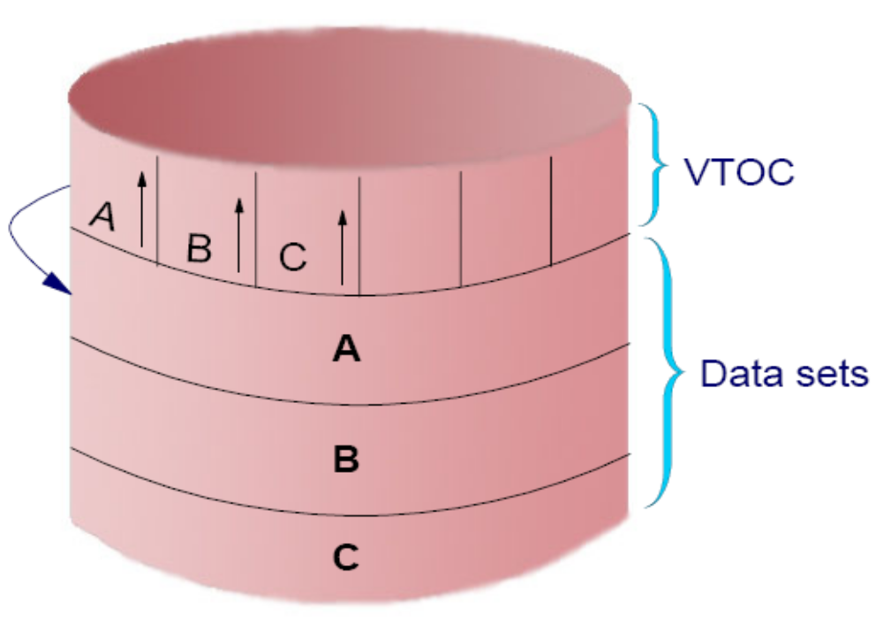
Volume Table of Contents

Slide 22
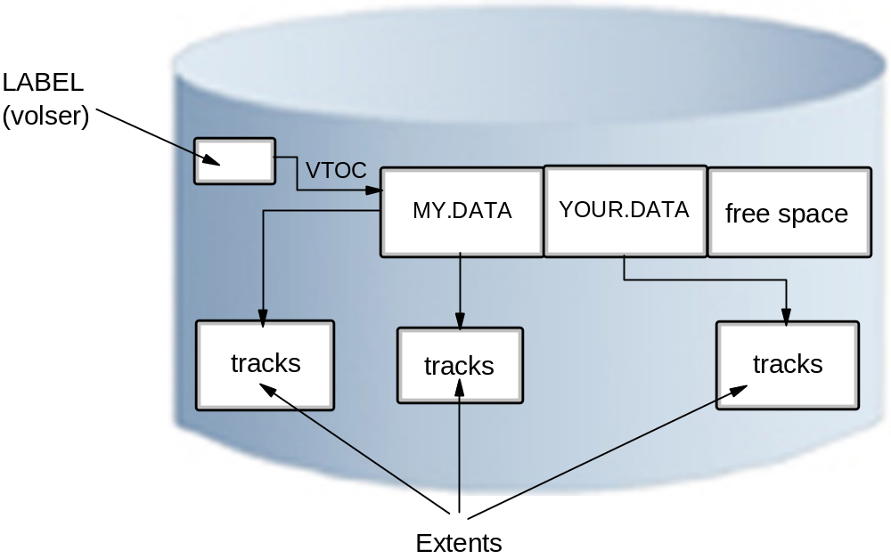
VTOC
Notes:
Record 1 on the first track of the first cylinder provides the label for the disk. It contains
the 6-character volume serial number (volser) and a pointer to the Volume Table Of
Contents (VTOC), which can be located anywhere on the disk.
The VTOC lists the data sets that reside on its volume, along with information about the
location and size of each data set, and other data set attributes. A standard z/OS utility
program, ICKDSF, is used to create the label and VTOC.
When a disk volume is initialized with ICKDSF, the owner can specify the location and
size of the VTOC. The size can be quite variable, ranging from a few tracks to perhaps
100 tracks, depending on the expected use of the volume. More data sets on the disk
volume require more space in the VTOC.
The VTOC also has entries for all the free space on the volume. Allocating space for a
data set (described later) causes system routines to examine the free space records,
update them, and create a new VTOC entry. Data sets are always an integral number of
tracks (or cylinders) and start at the beginning of a track (or cylinder).

Slide 23
How a catalog is used
A catalog associates a data set with the volume on which the data set is located.
Locating a data set requires:
  Data set name
  Volume name
  Unit (volume device type)
Typical z/OS system includes a master catalog and numerous user catalogs.
Notes:
A catalog describes data set attributes and indicates the volumes on which a data set is
located. Data sets can be cataloged, uncataloged, or recataloged. All system-managed
DASD data sets are cataloged automatically in a catalog. Cataloging of data sets on
magnetic tape is not required but usually it simplifies users jobs. All data sets can be
cataloged in a catalog.
In z/OS, the master catalog and user catalogs store the locations of data sets by name.
This means that data set names must be unique. Both disk and tape data sets can be
cataloged.
To find a data set that you have requested, z/OS must know three pieces of information:
Data set name
Volume name
Unit (the volume device type, such as a 3390 disk or 3590 tape)
You can specify all three values on ISPF panels or in JCL. However, the unit device type
and the volume are often not relevant to an end user or application program.

Slide 24
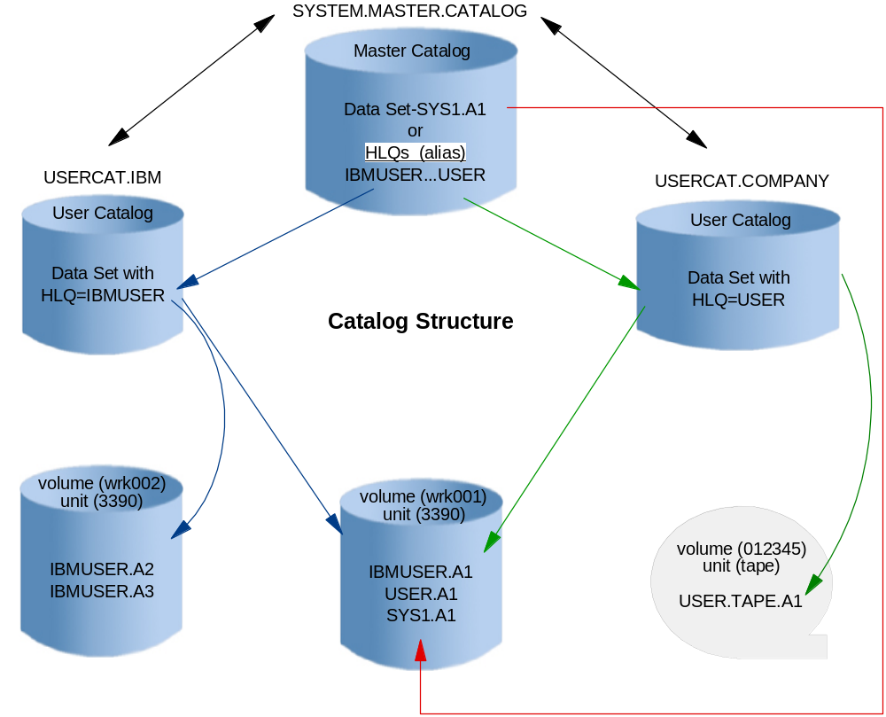
Catalog Structure
Notes:
A z/OS system always has at least one master catalog. If a z/OS system has a single
catalog, this catalog would be the master catalog and the location entries for all data sets
would be stored in it. A single catalog, however, would be neither efficient nor flexible,
so a typically z/OS system uses a master catalog and numerous user catalogs connected
to it as shown on the slide.
A user catalog stores the name and location of a data set (dsn/volume/unit). The master
catalog usually stores only a data set HLQ with the name of the user catalog, which
contains the location of all data sets prefixed by this HLQ. The HLQ is called an alias.
On the slide, the data set name of the master catalog is SYSTEM.MASTER.CATALOG. This
master catalog stores the full data set name and location of all data sets with a SYS1
prefix such as SYS1.A1. Two HLQ (alias) entries were defined to the master catalog,
IBMUSER and USER. The statement that defined that IBMUSER included the data set
name of the user catalog containing all the fully qualified IBMUSER data sets with their
respective location. The same is true for USER HLQ (alias).
When SYS1.A1 is requested, the master catalog returns the location information,
volume(WRK001) and unit(3390), to the requestor. When IBMUSER.A1 is requested,
the master catalog redirects the request to USERCAT.IBM, then USERCAT.IBM returns
the location information to the requestor.

Slide 25
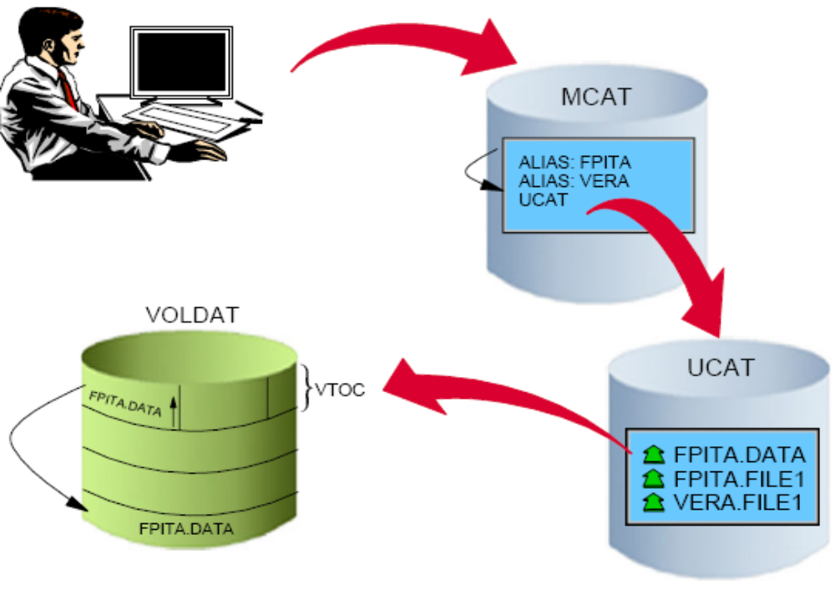
Locating a dataset in MVS

Slide 26
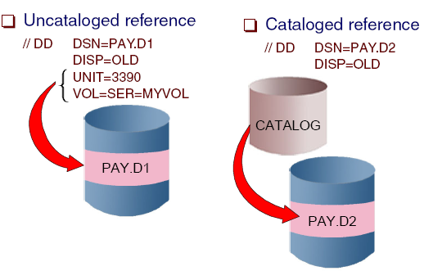
Catalog and Uncataloged Datasets
Note the ‘ // ‘ and parm statements used for Job Control Language

Slide 27
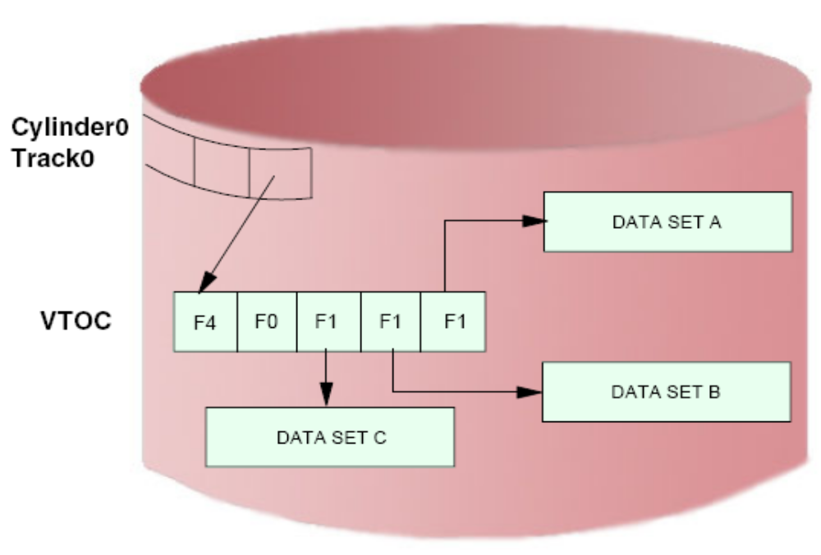
Dataset Control Blocks (DSCB)

Slide 28
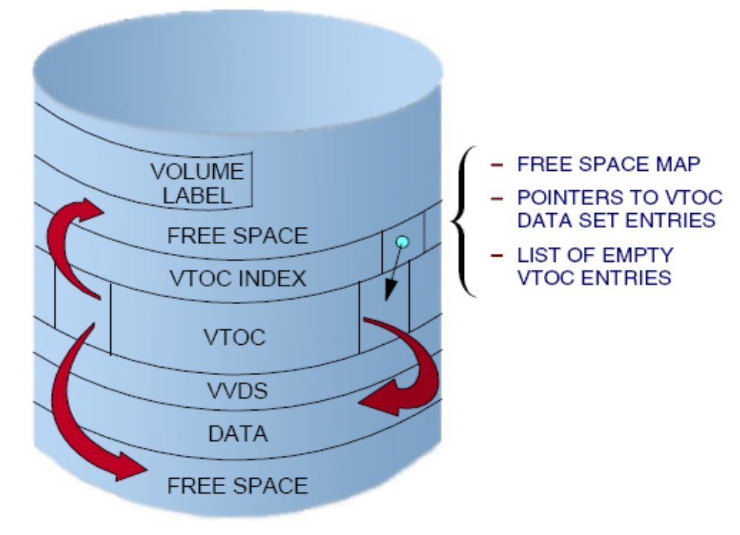
VTOC Index Structure
ISPF option 3.4

Slide 29
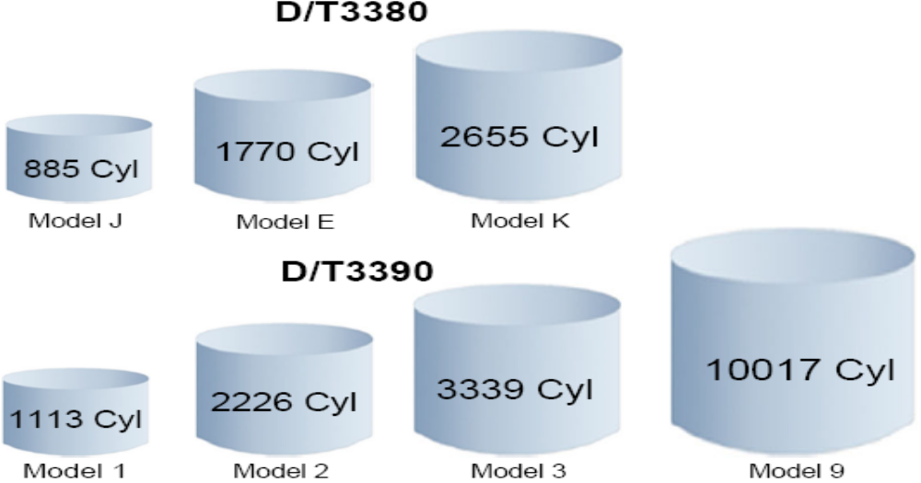
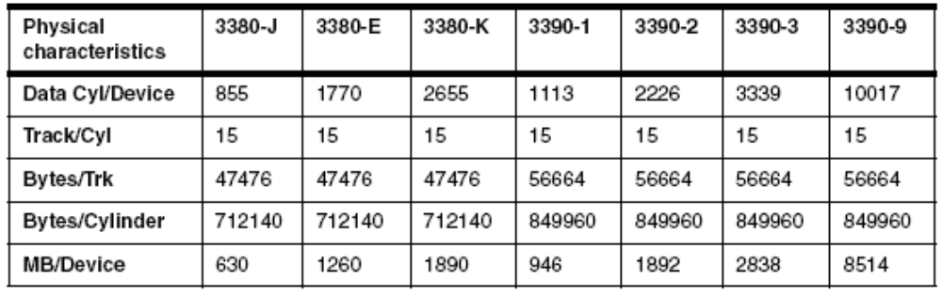
Traditional Disk Capacity (DASD)

Slide 30
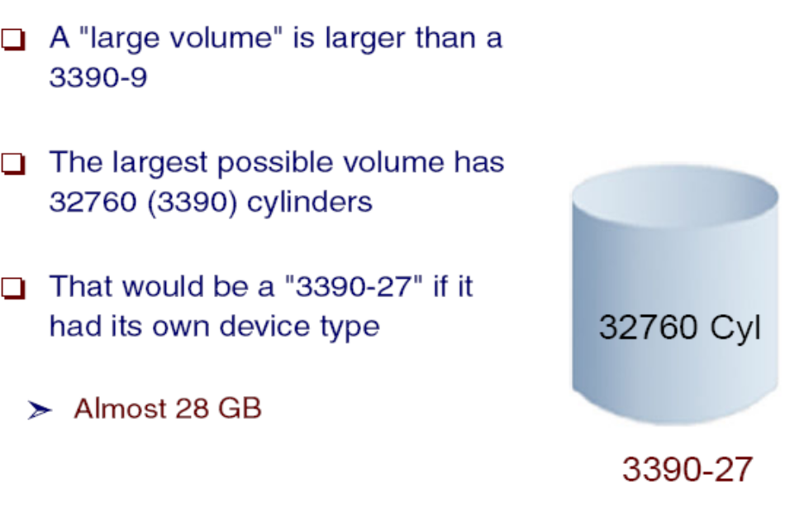
Large Volume (own device type)

Slide 31
Data management in z/OS
Data management involves all of the following tasks:
  allocation, placement, monitoring, migration, backup, recall, recovery, and deletion.
Storage management is done either manually or through automated processes (or through a combination or both).
In z/OS, DFSMS is used to automate storage management for data sets.
Notes:
In a z/OS system, data management involves allocation, placement, monitoring,
migration, backup, recall, recovery, and deletion. These activities can be done either
manually or through the use of automated processes. When data management is
automated, the operating system determines object placement, and automatically
manages object backup, movement, space, and security. A typical z/OS production
system includes both manual and automated processes for managing data sets.
Data management includes these main tasks:
Setting aside (allocating) space on DASD volumes
Automatically retrieving cataloged data sets by name
Mounting magnetic tape volumes in the drive
Establishing a logical connection between the application program and the medium
Controlling access to data
Transferring data between the application program and the medium
DFSMS performs the essential data, storage, program, and device
management functions of the system. DFSMS is a set of products, and one of these
products, DSFMSdfp, is required for running z/OS. DFSMS, together with hardware
products and installation-specific settings for data and resource management, provides
system-managed storage in a z/OS environment.
The heart of DFSMS is the Storage Management Subsystem (SMS). Using SMS, the
system programmer or storage administrator defines policies that automate the
management of storage and hardware devices. These policies describe data allocation
characteristics, performance and availability goals, backup and retention requirements,
and storage requirements for the system. SMS governs these policies for the system and
the Interactive Storage Management Facility (ISMF) provides the user interface for
defining and maintaining the policies.
The data sets allocated through SMS are called system-managed data sets or
SMS-managed data sets.

Slide 32
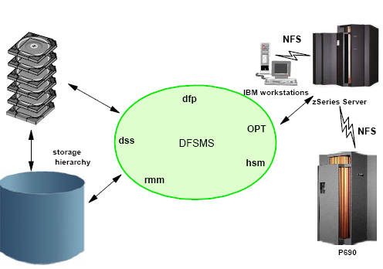
Data Facility Subsystem Managed Storage (DFSMS)
Rules based

Slide 33
VSAM
VSAM is Virtual Storage Access Method
VSAM provides more complex functions than other disk access methods
VSAM record formats:
  Key Sequence Data Set (KSDS)
  Entry Sequence Data Set (ESDS)
  Relative Record Data Set (RRDS)
  Linear Data Set (LDS)
Notes:
The term Virtual Storage Access Method (VSAM) applies to both a data set type and the
access method used to manage various user data types.
As an access method, VSAM provides much more complex functions than other disk
access methods. VSAM keeps disk records in a unique format that is not understandable
by other access methods.
VSAM is primarily for applications. It is not used for source programs, JCL, or
executable modules. VSAM files cannot be routinely displayed or edited with ISPF.
You can use VSAM to organize records into four types of data sets: key-sequenced,
entry-sequenced, linear, or relative record. The primary difference among these types of
data sets is the way their records are stored and accessed.

Slide 34
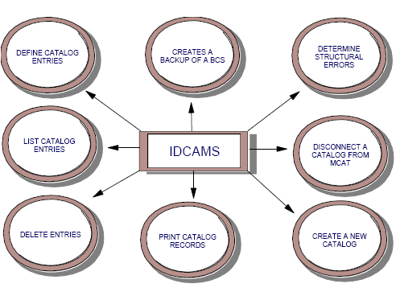
VSAM Access Method

Slide 35
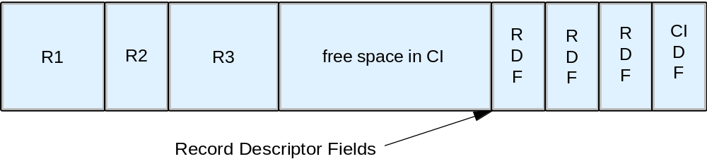
Simple VSAM control interval
Notes:
VSAM works with a logical data area known as a Control Interval (CI) that is
diagrammed in Figure 4-2. The default CI size is 4K bytes, but it can be up to 32K bytes.
The CI contains data records, unused space, Record Descriptor Fields (RDF), and a CI
Descriptor Field.
A control interval may be constructed from smaller disk blocks, but this level of detail is
internal to VSAM. Multiple control intervals are placed in a Control Area (CA). A
VSAM data set consists of control areas and index records. One form if index record is
the sequence set, which is the lowest-level indexes pointing to control intervals.
Typical use of VSAM permits an application to insert new records in a data set.

Slide 36
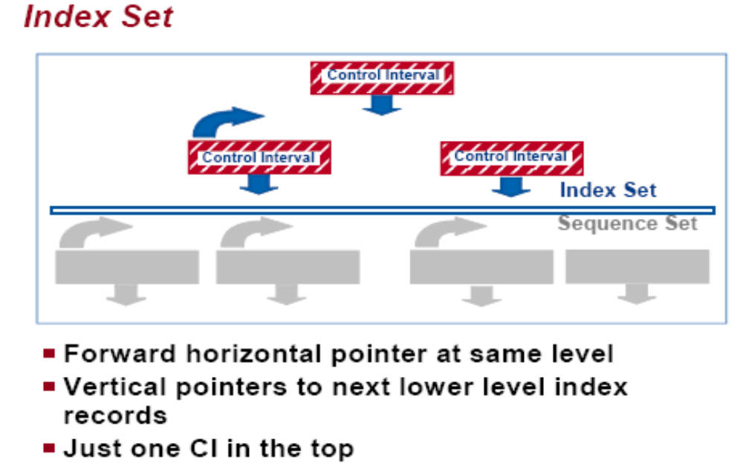
VSAM Index Structure

Slide 37
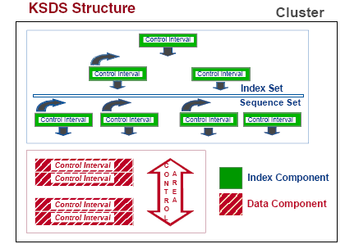
VSAM Keyed Dataset

Slide 38
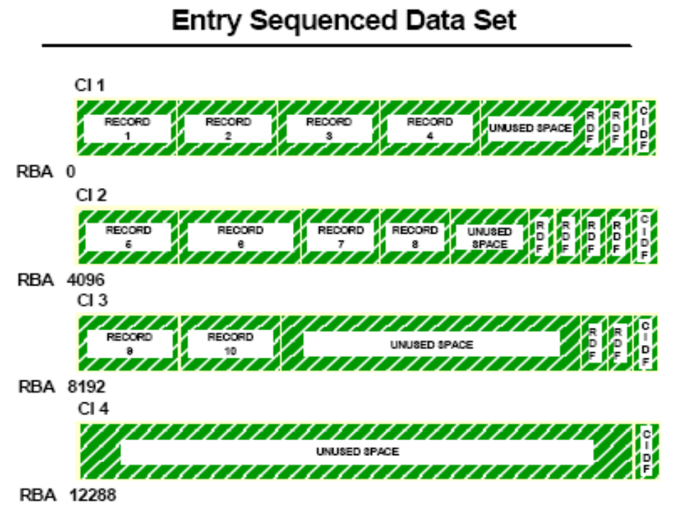
VSAM Sequential Dataset = ESDS

Slide 39
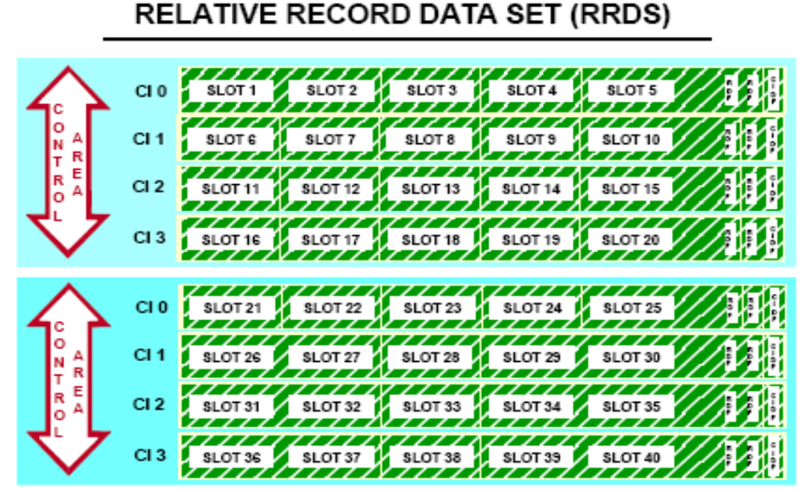
VSAM - RRDS

Slide 40
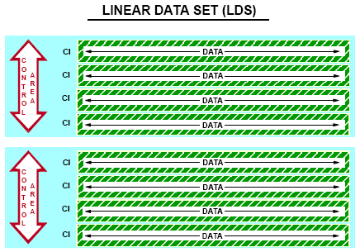
VSAM LDS

Slide 41
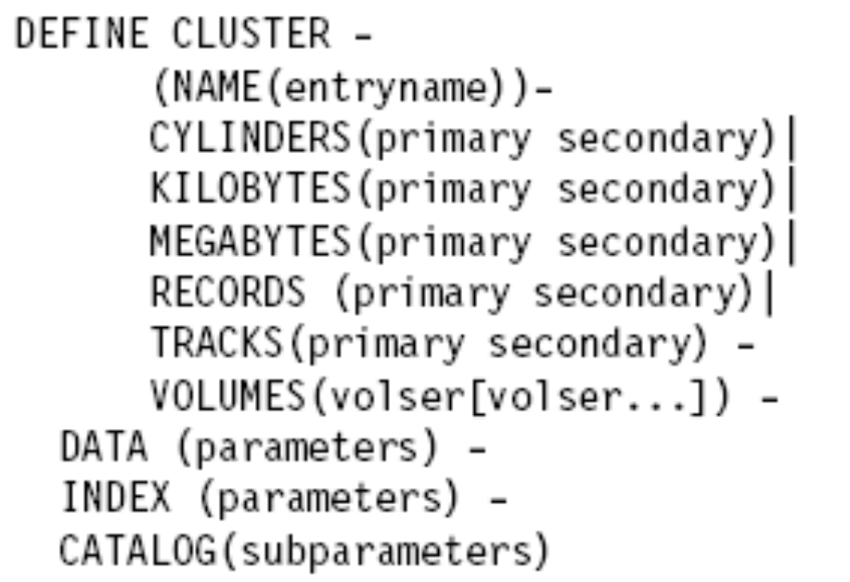
Basic Parms for VSAM dataset

Slide 42
z/OS UNIX file systems
z/OS UNIX System Services (z/OS UNIX) allows z/OS to access UNIX files.
A z/OS UNIX file system is hierarchical and byte-oriented.
Files in the UNIX file system are sequential files and are accessed as byte streams.
UNIX files and traditional z/OS data sets can reside on the same DASD volume.
Notes:
z/OS UNIX System Services (z/OS UNIX) allows z/OS to access UNIX files. UNIX
applications also can access z/OS data sets. You can use the hierarchical file system
(HFS), z/OS Network File System (z/OS NFS), zSeries File System (zFS), and
temporary file system (TFS) with z/OS UNIX.
A z/OS UNIX file system is hierarchical and byte-oriented. Finding a file in the file
system is done by searching a directory or a series of directories (see the next slide). There
is no concept of a z/OS catalog that points directly to a file.

Slide 43
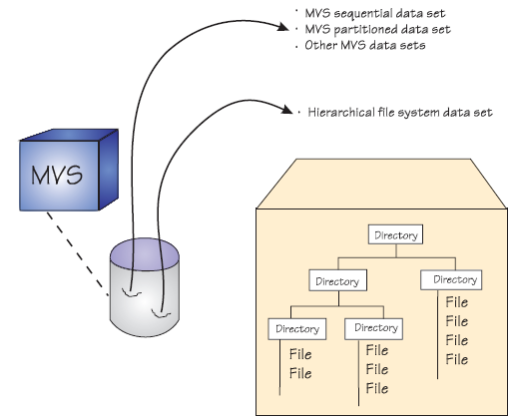
MVS and File Systems

Slide 44
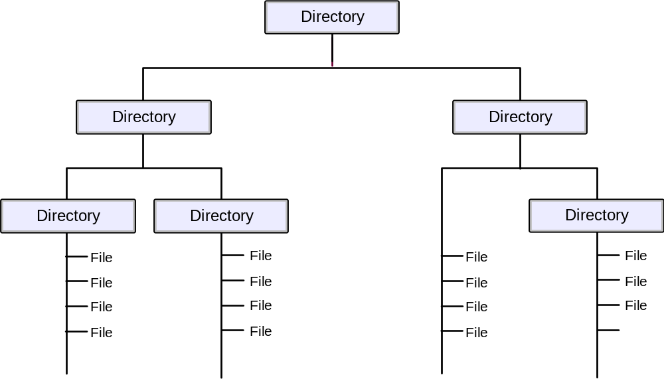
UNIX file system structure
Notes:
A path name identifies a file and consists of directory names and a file name. A fully
qualified file name, which consists of the name of each directory in the path to a file plus
the file name itself, can be up to 1023 bytes long. The hierarchical file system allows for
file names in mixed case.
The path name is constructed of individual directory names and a file name separated by
the forward-slash character, for example:
/dir1/dir2/dir3/myfile
Like UNIX, z/OS UNIX is case-sensitive for file and directory names. For example, in
the same directory, the file MYFILE is a different file than myfile.
The files in the hierarchical file system are sequential files, and are accessed as byte
streams. A record concept does not exist with these files other than the structure defined
by an application.
The hierarchical file system (HFS) data set which contains the hierarchical file system is
a z/OS data set type.
HFS data sets and z/OS data sets can reside on the same DASD volume.

Slide 45
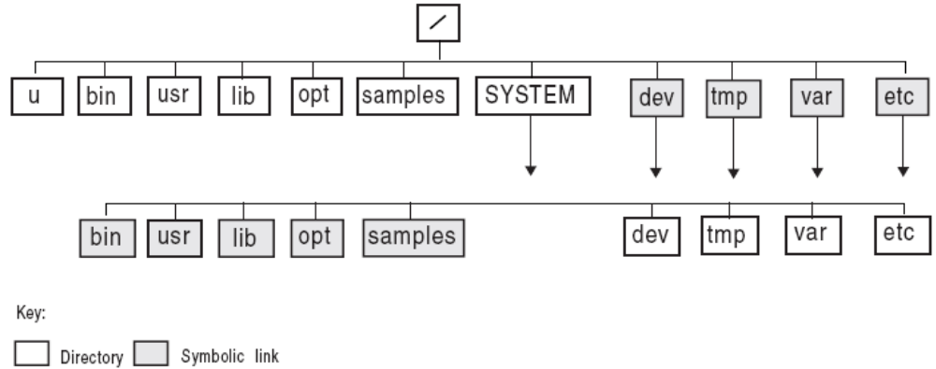
Organization of the File System

Slide 46
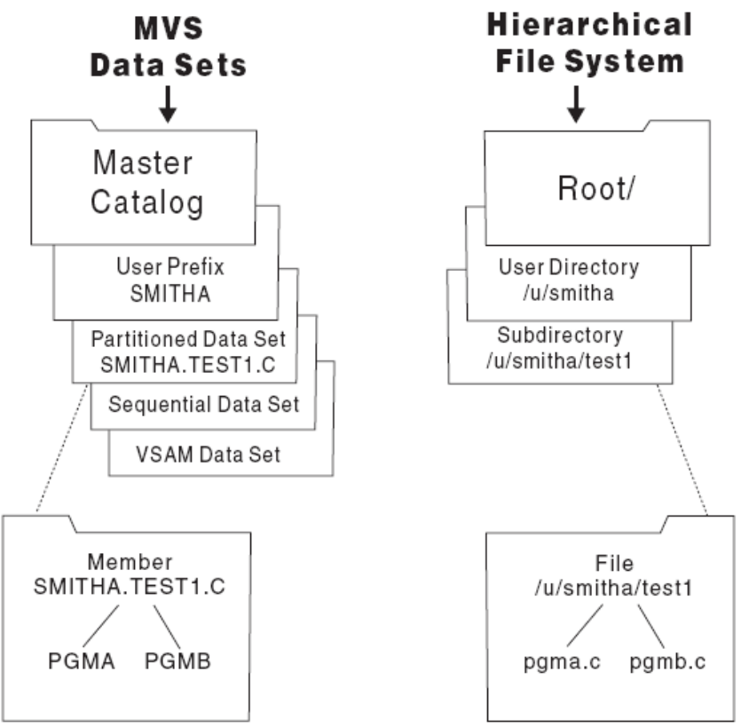
Comparison of MVS Datasets and UNIX HFS

Slide 47
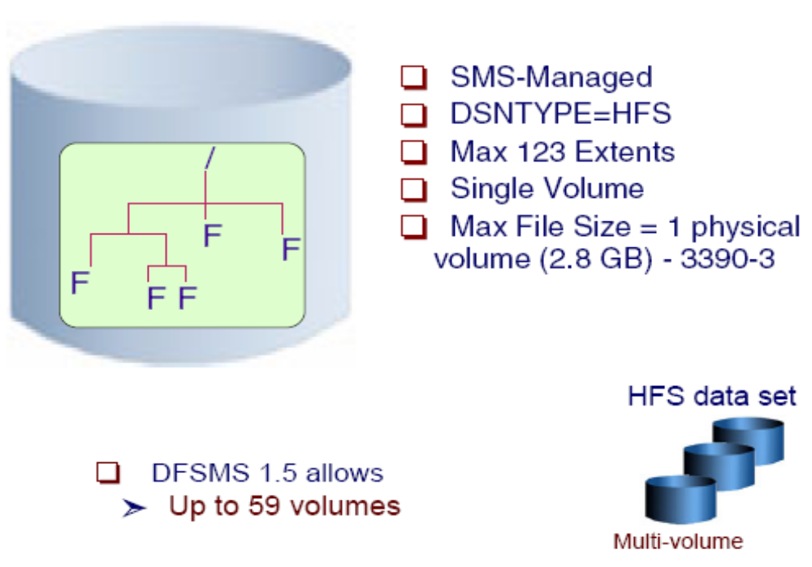
File System Attributes
Take screenshot

Slide 48
Summary
A data set is a collection of logically related data (programs or files)
Data sets are stored on disk drives (DASD) and tape.
Most z/OS data processing is record-oriented. Byte stream files are not present in traditional processing, except in z/OS UNIX.
z/OS records follow well-defined formats, based on record format (RECFM), logical record length (LRECL), and the maximum block size (BLKSIZE).
z/OS data set names have up to 44 characters, divided by periods into qualifiers.

Slide 49
Summary (continued)
Catalogs are used to locate data sets.
VSAM is an access method that provides more complex functions than other disk access methods.
z/OS libraries are known as partitioned data sets (PDS or PDSE) and contain members.
A file in the hierarchical file system can be either a text file or a binary file.
z/OS treats an entire UNIX file system hierarchy as a collection of “data sets.” Each data set is a mountable file system.

